Slide 1
DoubleMLDeep: Estimation of Causal Effects with Multimodal Data
February 20, 2024
Sven Klaassen University of Hamburg Economic AI
Jan Teichert-Kluge University of Hamburg
Philipp Bach University of Hamburg Economic AI
Victor Chernozhukov Massachusetts Instituteof Technology
Martin Spindler University of Hamburg Economic AI
Suhas Vijaykumar Massachusetts Instituteof Technology
Notes:
Hello everyone, I am very pleased to be here today to present the first results of our research project on “DoubleMLDeep: Estimation of Causal Effects with Multimodal Data”! Our research group consists of
…
My name is Jan Teichert-Kluge, and I am a research associate and PhD student at the University of Hamburg in the field of statistics with applications in business administration and data science. In my research, I focus on the exciting fields of machine learning, especially deep learning, and causal inference. I look forward to networking with you after my presentation and having further discussions on the topics of statistics, machine learning and causal inference.

Slide 2
Motivation
Motivating Example - Data Sources
Image Data
Text Data
Tabular Data
Motivating Examples
Example Use Cases:
  Price Elasticity
  Effects of medical treatments
  Effects on the environment, e.g. the effect of condensation trails on the climate
Sources like images and text contain valuable insights
  Contain rich hidden information about unobserved confounding variables
Motivating Example - PLR
Partially linear regression model (PLR)
$$\begin{matrix}Y & =θ_{0}D+g_{0}\left(X\right)+ε, & E\left[ε|X,D\right]=0 \\ D & =m_{0}\left(X\right)+ϑ, & E\left[ϑ|X\right]=0\end{matrix}$$
with
Notes:
I would like to start with our motivation for this project. A major motivating factor is the growth in data volumes in the course of global digitalization. More and more unstructured data is also becoming available -> keyword: big data.
So, here you see the website of a well-known online store. There is a lot of data behind it, but not all of it is publicly accessible. However, most online stores have published - photos of their products - a description of the products as text - some tabular data such as the average rating or the number of reviews on the product page
…
What all examples have in common is:

Slide 3
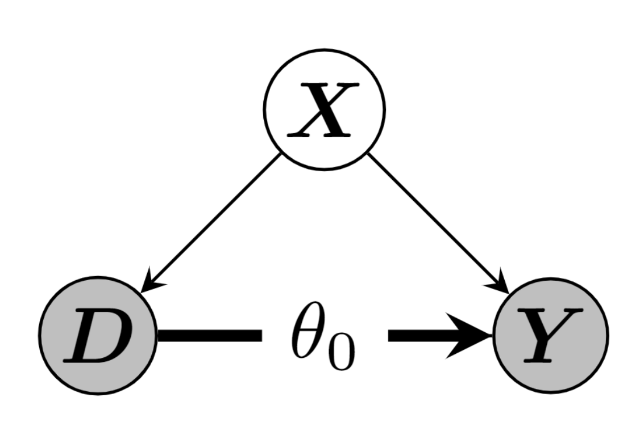
Output $Y$
Treatment $D$
Additional features $X=\left(X_{1},…\right)$
Stochastic errors $ε$ and $ϑ$
DAG for PLR Model
Notes:
The question now is how to estimate the causal effect!
We define this partial linear regression model with the outcome Y and treatment D. Possible confounders are selected as X.
This causal model is shown here as a DAG (directed acyclic graph).

Slide 4
Motivating Example - DML
Double/Debiased Machine Learning (DML)
Use machine learning methods to fit
$$\begin{matrix}l_{0}\left(X\right) & :=E\left[Y|X\right] \\ m_{0}\left(X\right) & :=E\left[D|X\right]\end{matrix}$$
Construct the orthogonalized score (either cross-fitting or split the sample) for a fitted nuisance learner ${\hat{η}}_{0}:=\left({\hat{l}}_{0},{\hat{m}}_{0}\right)$
$$\begin{matrix}ψ\left(W,θ,\hat{η}\right):=\left(Y−\hat{l}\left(X\right)−θ\left(D−\hat{m}\left(X\right)\right)\right)⋅\left(D−\hat{m}\left(X\right)\right)\end{matrix}$$
Compute the estimate as the solution of
$$0=\frac{1}{n}\sum_{i=1}^{n}{ψ}\left(W,\hat{θ},{\hat{η}}_{0}\right)$$
Motivating Example - DML
Assumptions for the nuisance elements (see Chernozhukov et al. (2018))
$$\begin{matrix}∥\hat{m}\left(X\right)−m_{0}\left(X\right)∥_{P,2}⋅\left(∥\hat{m}\left(X\right)−m_{0}\left(X\right)∥_{P,2}+∥\hat{l}\left(X\right)−l_{0}\left(X\right)∥_{P,2}\right)≤δ_{n}n^{−1/2}.\end{matrix}$$
Under some regularity conditions the estimator $\hat{θ}$ concentrates in $1/\sqrt{n}$-neighborhood of $θ_{0}$ and
$$\sqrt{n}\left(\hat{θ}−θ_{0}\right)→N\left(0,σ^{2}\right)$$
. . .
$⇒$ simple approach to control for confounders, if they can be used for ML models!
Notes:
We use ML methods to learn the conditional expected values of Y on X, respectively D on X.
Then we use this orth. score and solve this equation to get the estimate theta hat!
On the final step, we calculate the estimate by solving the following equation:
We rely on the approach of Chernozhukov et al. (2018)
This estimator has, under certain conditions, nice properties!

Slide 5
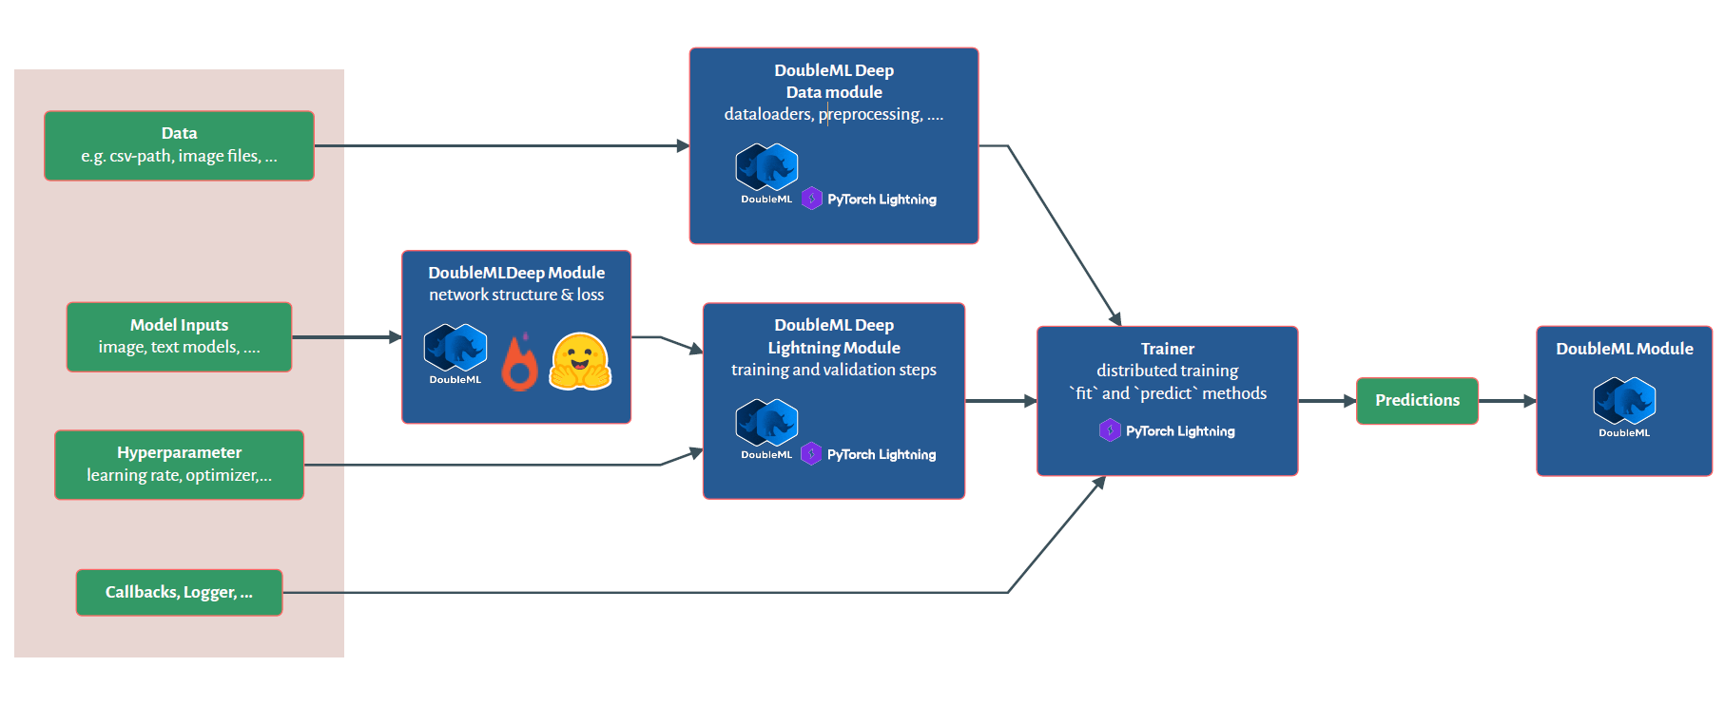
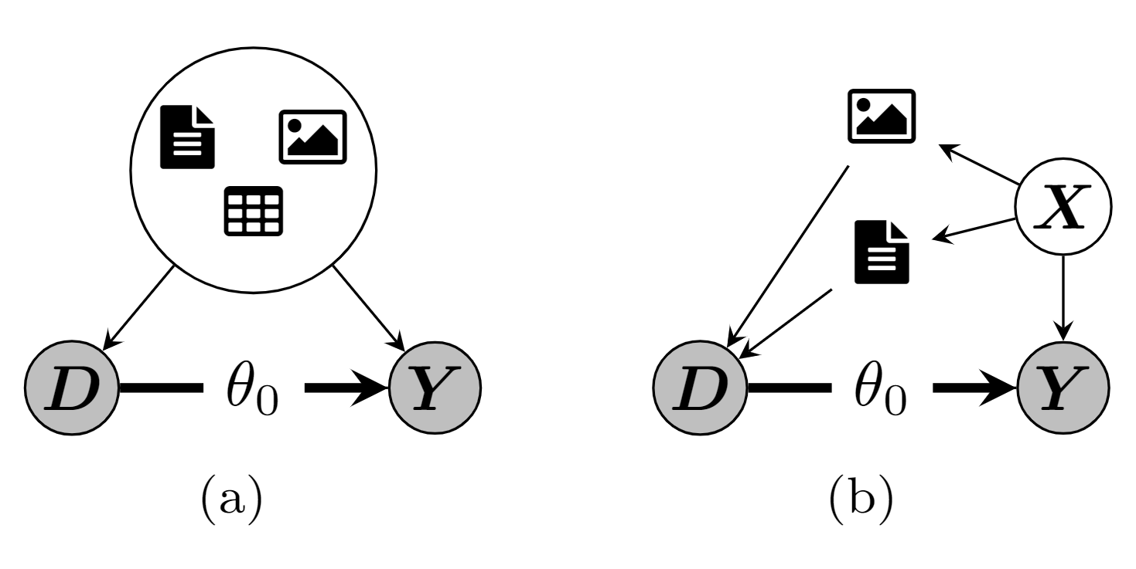
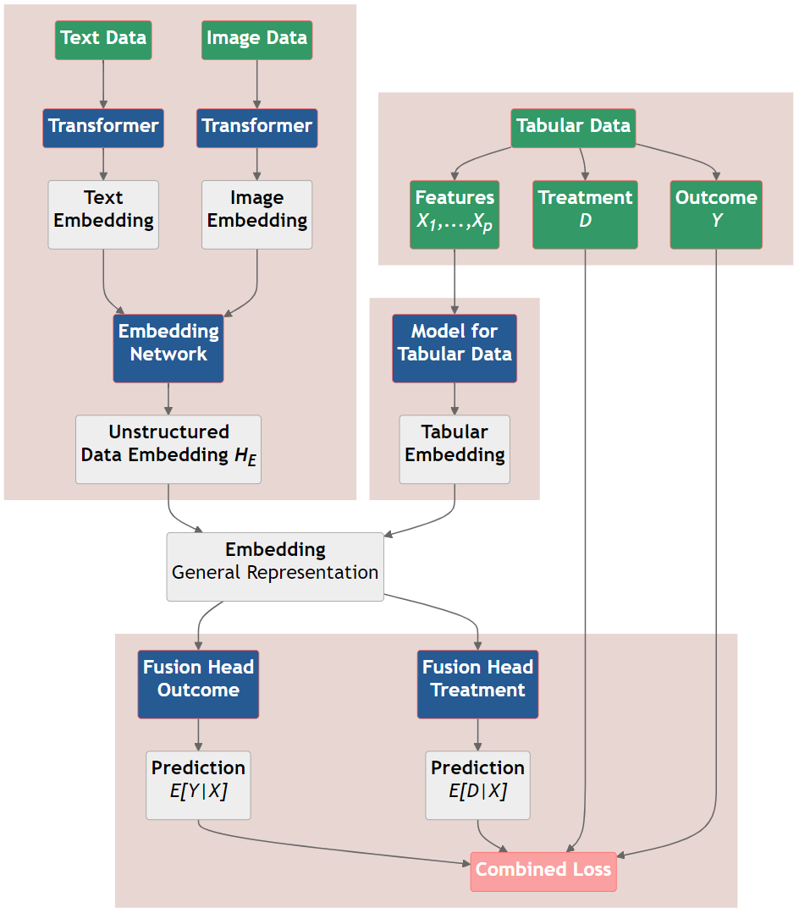
DoubleML Deep
DoubleML Deep - Motivation
Use multimodal data (text and images) additionally to conventional tabular features
DoubleML Deep - Module Structure
DoubleML Deep - Workflow
DoubleML Deep - More Details
Use pretrained models for unstructured data e.g. Bert and Beit
Basic models for tabular data seem sufficient
Monitor the nuisance losses
  $∥Y−\hat{l}\left(X\right)∥_{P,2}≤∥l_{0}\left(X\right)−\hat{l}\left(X\right)∥_{P,2}+σ_{ϵ}$
  $∥D−\hat{m}\left(X\right)∥_{P,2}≤∥m_{0}\left(X\right)−\hat{m}\left(X\right)∥_{P,2}+σ_{ϑ}$
Examples of directed acyclic graphs (DAGs) with image and text confounding. (a) Direct confounding via image, text and tabular data. (b) Treatment decision is driven by text and images. All backdoor paths are blocked by conditioning on both image and text data.
High-Level PLR Model Architecture. Both nuisance components are trained simultaneously with a combined loss.
High-Level Workflow of DoubleMLDeep
Notes:
Now I would like to briefly explain the workflow of DoubleMLDeep in Python. wor First of all, some necessary input parameters must be defined. Then the actual DoubleMLDeep network can be created, which uses Hugging Face Transformer models and the Pytorch framework, among other things.
A DoubleMLDeep Data Module must be created and handles the various input data such as texts and images. This uses the Pytorch Lightning Framework.
The DoubleMLDeep Lightning Module also uses Pytorch Lightning and contains additional training parameters.
The network can now be trained with the pytorch Lightning Trainer. The corresponding predictions in the DoubleML package can then be used to obtain the estimate of the causal parameter.
Unstructured Data Models: We employ pre-trained models like BERT and BEiT to extract valuable information from unstructured data, including product descriptions and images.
Tabular Data Models: Basic models for tabular data have proven to be effective.
Monitoring Nuisance Losses: To ensure the reliability of our estimations, we diligently monitor nuisance losses. The following conditions are crucial for assessing the quality of our models:
\lVert Y - \hat{l}(X) \rVert_{P,2} &\le \lVert l_0 - \hat{l}(X) \rVert_{P,2} + \sigma_{\epsilon}
$ D - (X) {P,2} &m_0(X) - (X){P,2} + _{}$
These conditions help maintain the validity of our estimates by ensuring that the discrepancies between our estimated nuisance functions and their true counterparts, along with stochastic errors, remain within acceptable bounds.

Slide 6
Semi-Synthetic Data
Modality | Dataset used
Tabular | DIAMONDS dataset
Text | IMDB dataset
Image | CIFAR-10 dataset
Construction of a semi-synthetic dataset
The validation of the proposed estimator is a crucial step in ensuring their accuracy and reliability.
  Performance of causal models is not straightforward to evaluate in real world applications
  The true causal effect (unlike true labels for predicted outcomes) is not observable
Construction of a semi-synthetic dataset
We generate a semi-synthetic dataset with a known treatment effect parameter
  The confounding operates through labels of the supervised learning tasks
We use the following datasets:
Notes:
…

Slide 7
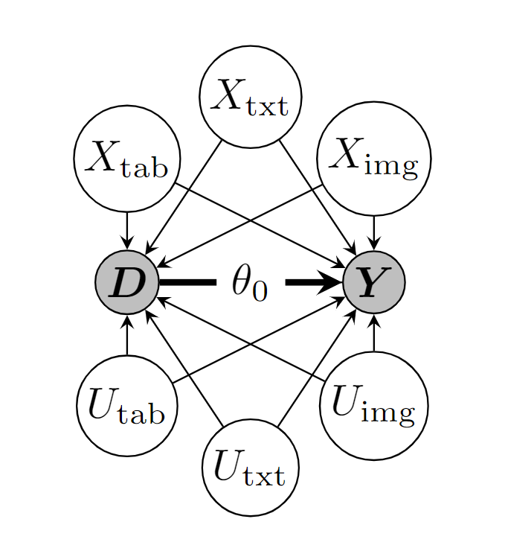
Construction of a semi-synthetic dataset
We generate a semi-synthetic dataset according to the underlying PLR model
$$\begin{matrix}Y & =θ_{0}D+{\tilde{g}}_{0}\left(\tilde{X}\right)+ε, \\ D & ={\tilde{m}}_{0}\left(\tilde{X}\right)+ϑ,\end{matrix}$$
where $\tilde{X}=\left({\tilde{X}}_{\text{tab}},{\tilde{X}}_{\text{txt}},{\tilde{X}}_{\text{img}}\right)$ with the following additive structure
g0X=mod∈{tab,txt,img}​gmodXmodm0X=mod∈{tab,txt,img}​mmodXmod
and $ε,ϑ∼N\left(0,1\right)$.
Construction of a semi-synthetic dataset
The effect on the outcome $Y$ is generated via a standardized version of target variable to balance the confounding impact of all modalities:
$$\begin{matrix}{\tilde{g}}_{\text{mod}}\left({\tilde{X}}_{\text{mod}}\right)=\frac{{\tilde{X}}_{\text{mod}}−E\left[{\tilde{X}}_{\text{mod}}\right]}{σ_{{\tilde{X}}_{\text{mod}}}}, \text{mod}∈\{\text{tab},\text{txt},\text{img}\}\end{matrix}$$
Further, to ensure a strong confounding, the impact on the treatment $D$ is defined via:
$$\begin{matrix}{\tilde{m}}_{\text{mod}}\left({\tilde{X}}_{\text{mod}}\right)=−{\tilde{g}}_{\text{mod}}\left({\tilde{X}}_{\text{mod}}\right), \text{mod}∈\{\text{tab},\text{txt},\text{img}\}\end{matrix}$$
Construction of a semi-synthetic dataset
Due to the negative sign and the additive structure, the confounding effect will ensure that higher outcomes $Y$ occur with lower treatment values $D$, creating a negative bias
  The independence of all three original datasets and the additive negative confounding results in a negative bias even if we only control for a subset of confounding factors
Construction of a semi-synthetic dataset
The treatment effect is set to $θ_{0}=0.5$ with $n=50.000$ samples in the dataset
The confounding is generated through the labels ${\tilde{X}}_{\text{mod}}$ of the corresponding dataset
Both ${\tilde{g}}_{0}\left(X\right)$ and ${\tilde{m}}_{0}\left(X\right)$ are rescaled to ensure a signal-to-noise ratio of $2$ for $Y$ and $D$ (given unit variances of the error terms)
Challenges of the proposed dataset
Dependency on the target of the modality ${\tilde{X}}_{\text{mod}}$
  Might not be fully explained by the corresponding features $X_{\text{mod}}$
Consequently, the estimate $\hat{θ}$ might only be able to account for the part of confounding which can be explained by the input features:
$$\begin{matrix}{\tilde{X}}_{\text{mod}}=E\left[{\tilde{X}}_{\text{mod}}|X_{\text{mod}}\right]+U_{\text{mod}},\end{matrix}$$
where $U_{\text{mod}}$ can not be controlled for
Bounds for the estimation of $θ_{0}$
Since all modalities contribute a negative bias, the semi-synthetic dataset can be used as a benchmark with an oracle upper bound of an effect estimate of $θ_{0}=0.5$
For the lower bound, one can evaluate a basic ordinary least squares model with outcome $Y$ on the treatment variable $D$ (excluding all confounding variables)
  The resulting effect estimate ${\hat{θ}}_{\text{OLS}}=−0.4594$
Bounds for the estimation of $θ_{0}$
To access the predictive performance of the nuisance models, we can rely on oracle predictions of
$$\begin{matrix}{\tilde{m}}_{0}\left(\tilde{X}\right):=E\left[D|\tilde{X}\right] \\ {\tilde{l}}_{0}\left(\tilde{X}\right):=E\left[Y|\tilde{X}\right] & =θ_{0}{\tilde{m}}_{0}\left(\tilde{X}\right)+{\tilde{g}}_{0}\left(\tilde{X}\right)\end{matrix}$$
Evaluating the oracle predictions ${\tilde{m}}_{0}\left(\tilde{X}\right)$ and ${\tilde{l}}_{0}\left(\tilde{X}\right)$ results in the following upper bounds for the performance of the nuisance estimators
$$\begin{matrix}R^{2}\left(D,{\tilde{m}}_{0}\left(\tilde{X}\right)\right) & =0.6713 \\ R^{2}\left(Y,{\tilde{l}}_{0}\left(\tilde{X}\right)\right) & =0.5845\end{matrix}$$
on the whole dataset of $n=50,000$ observations
Simulation Results
DAG for the semi-synthetic dataset. The confounding via the features $X=\left(X_{\text{tab}},X_{\text{txt}},X_{\text{img}}\right)$ can be adjusted for, whereas the unexplained/noise parts $U=\left(U_{\text{tab}},U_{\text{txt}},U_{\text{img}}\right)$ are unobserved.
Notes:
…
…

Slide 8
Baseline Model
  Standard DML approach, relying only on tabular data
  Based on the LightGBM package for estimation of the nuisance elements
Deep Model
  Relies on the proposed architecture
  Uses the out-of-sample predictions of $\hat{m}\left(X\right)$ and $\hat{l}\left(X\right)$ generated from the model
  Based on the RoBERTa Model for text modality, a VIT Model for images and a SAINT model for the tabular data

Slide 9
 | Baseline | Embedding | Deep
$r^{2}\left(Y,{\hat{l}}_{0}\right)$ | $0.31±0.01$ | $0.87±0.02$ | $0.90±0.01$
$r^{2}\left(D,{\hat{m}}_{0}\right)$ | $0.31±0.01$ | $0.87±0.02$ | $0.90±0.01$
$\hat{θ}$ | $−0.32±0.01$ | $0.28±0.01$ | $0.27±0.01$
Simulation Results
In order to compare the predictive performance of the models, a relative $r^{2}$-score with respect to the upper bound is defined as
$$\begin{matrix}0≤r^{2}\left(D,\hat{m}\right) & :=\frac{R^{2}\left(D,\hat{m}\left(X\right)\right)}{R^{2}\left(D,{\tilde{m}}_{0}\left(\tilde{X}\right)\right)}≤1 \\ 0≤r^{2}\left(Y,\hat{l}\right) & :=\frac{R^{2}\left(Y,\hat{l}\left(X\right)\right)}{R^{2}\left(Y,{\tilde{l}}_{0}\left(\tilde{X}\right)\right)}≤1\end{matrix}$$
Simulation Results
Results of Simulation Study. Reported: mean ± sd. over five random train-test splits

Slide 10
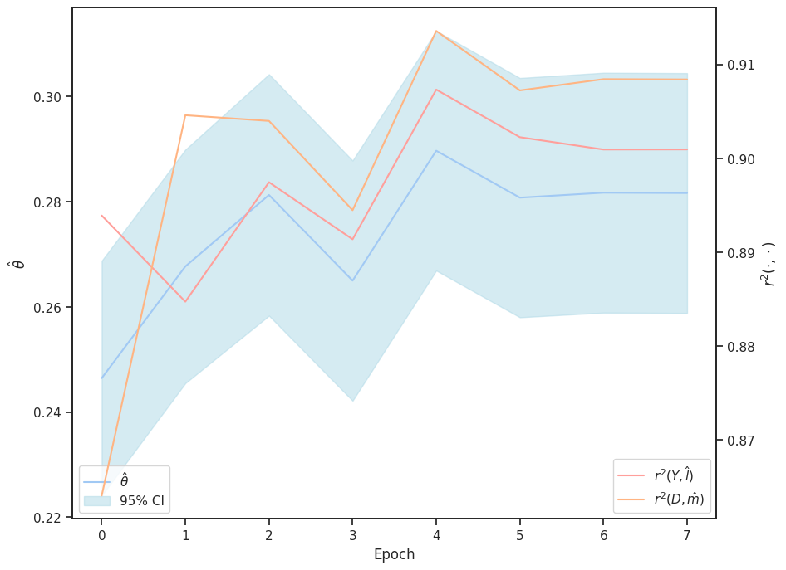
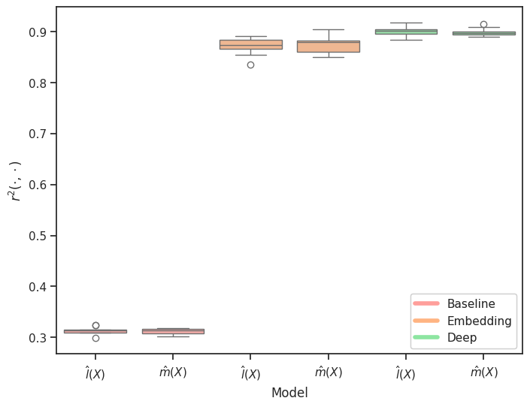
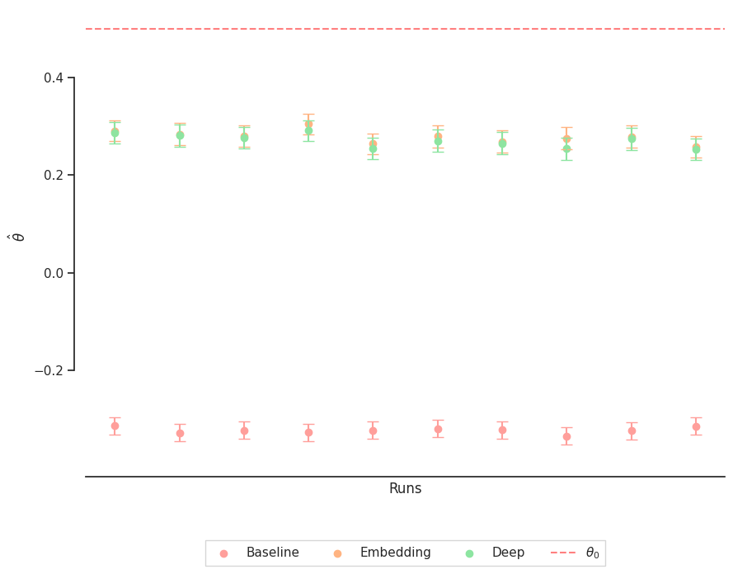
Higher = better (best in bold)
Simulation Results - Predictive Performance
Simulation Results - Performance on $θ$
Simulation Results - Continous Estimates on $θ$
Future Research Direction
Further applications (We are really looking forward to possible collaborations)
Extensions of the DoubleML package
Using multiple time periods
Case Studies
Boxplots of $r^{2}$-Scores. As anticipated, the tabular data provides only $30\%$ explanatory power, but the inclusion of unstructured data increases the predictable variance to approximately $90\%$.
Boxplots of $\hat{θ}$. The Embedding Model and Deep Model have similar estimates. This indicates a stable and information-rich embedding $H_{E}$, which provides a high explanatory contribution independent of the subsequent ML method for predicting $Y$ and $D$. $θ_{0}$ represents the upper bound.
Continuous estimation of $θ_{0}$. Both, the $r^{2}$-scores and the coefficient estimates gradually converge to stable values over the epochs.

Slide 11
References
References
Bach, Philipp, Victor Chernozhukov, Malte S Kurz, and Martin Spindler. 2022. “DoubleML-an Object-Oriented Implementation of Double Machine Learning in Python.” Journal of Machine Learning Research 23: 53–51.
Chernozhukov, Victor, Denis Chetverikov, Mert Demirer, Esther Duflo, Christian Hansen, Whitney Newey, and James Robins. 2018. “Double/Debiased Machine Learning for Treatment and Structural Parameters.” The Econometrics Journal 21 (1): C1–68. https://onlinelibrary.wiley.com/doi/abs/10.1111/ectj.12097.
Affiliations
University of Hamburg
https://www.bwl.uni-hamburg.de/en/statistik/allgemein.html
Massachusetts Institute of Technology
https://stat.mit.edu/about/
Economic AI
https://economicai.com/
DoubleML
https://docs.doubleml.org/stable/index.html
. . .
$⇒$ Thanks for your Attention!
Notes:
Economic AI: for industry collaborations and trainings on doubleml please check out the website of economicai.com !

